Slide 1
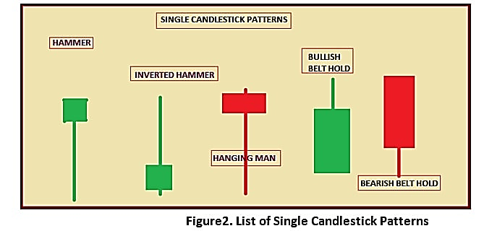
GOD’S EYE
THE RETAIL TRADERS BEST FRIEND

Slide 2
WHAT ARE CANDLESTICKS & WHY ARE THEY IMPORTANT
Candlesticks are important for trading analysis because they are considered as a visual representation of what is going on in the market.
Trading and investing are games of probabilities and risk management. For this reason, proper interpretation and prediction of the market language is essential to maintaining profitability.
An extensive study of candlestick charts and patterns, combined with an analytical mindset and enough practice eventually provide traders with an edge over the market.

Slide 3
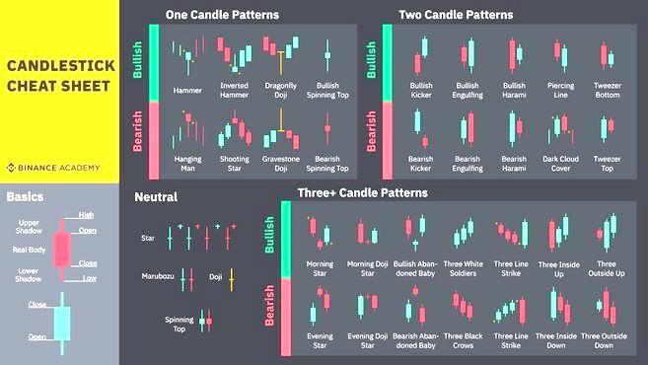
CANDLE STICK PATTERNS

Slide 4
THE VISION AND ITS VALUE
VISION
VALUE
To create a user friendly app that aids the growing demographic of retail investors to make consistently profitable trades in the financial markets.
Automates the following processes:
Trend identification using multiple time frames
Marks out key support and resistance lines .
Uses visual recognition and predictive algorithms to match any chart to the relevant market psychology (price action signal)
Fills the knowledge gap that causes retail investors to lose a good portion of their hard earned cash and profits on the market.
Gives the trader the insight to identify high probability setups in the market
Provides a 70% success chance of sustained profitability in financial markets.
To convey and visualize the buying and selling forces that ultimately drive the markets to the retail investor.

Slide 5
KEY COMPONENTS TO BE AUTOMATED
TREND SPOTTING (CHOPPY/TRENDING/RANGING)
DRAWING KEY SUPPORT AND RESISTANCE LEVELS
INTERPRETING THE APPROPRIATE MARKET SENTIMENT FROM CANDLE SIGNALS
SUGGESTING MOST RELEVANT PRICE ACTION STRATEGIES USING FUNDAMENTALS & CONFLUNCE.
MARKING OUT PROFIT TARGET AND EXIT STRATEGY FROM ANY LONG OR SHORT TRADE.

Slide 6
FLOW CHART FOR USER INTERFACE
PROMPTS USER TO TAKE PICTURES OF CHART ON DIFFERENT TIME FRAMES
DRAWS KEY SUPPORT, RESISTANCE & TREND LINES
IDENTIFIES PREVAILING MARKET PSYCHOLOGY USING CANDLE STICK PATTERNS AND CONFLUENCE
INSTRUCTS THE USER ON HIGH PROBABILITY SETUP FOR LONG OR SHORT TRADE
SETS STOP LOSS AND PROFIT TARGET FOR THE USER

Slide 7
competitors
PROFESSIONAL STOCK CHART
DATAMELON
INVESTAR
STOCK SPY
EDELWEISS MOBILE TRADER

Slide 8
UNIQUE SELLING POINT
An attractive an easy to use app that helps the user do the following:
Performs Technical analysis, trend spotting and price prediction for the user
Calculates how much profit or loss could be accrued from any chart setup.
Instructs the user on where to set stop loss order (Risk and Money management)
Also gives the user a defined profit target based on chart setup (Exit strategy)
Allows the user forget about his/her trade and be guaranteed profitability.
Trading is for patient people, who know how to manage risk and make trading plans, scenarios, prediction models.

Slide 9
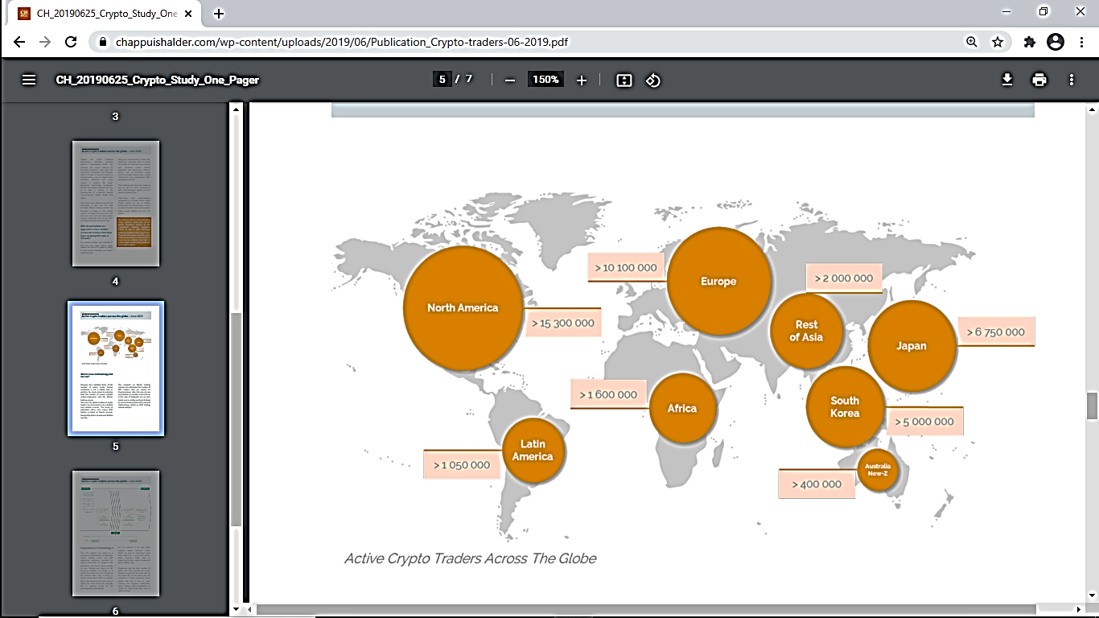
WHATS OUR MARKET ??
80% of traders are operating at barely break even or at a loss.
55 Million active crypto traders exist globally and this number is growing daily.
Our app should also be able to support the already established FOREX, STOCKS & FUTURES MARKET
This makes our app marketable and of value to at least 250 million retail traders globally
A subscription based model of between $5-10 will indicate a very hefty reward for our efforts

Slide 10
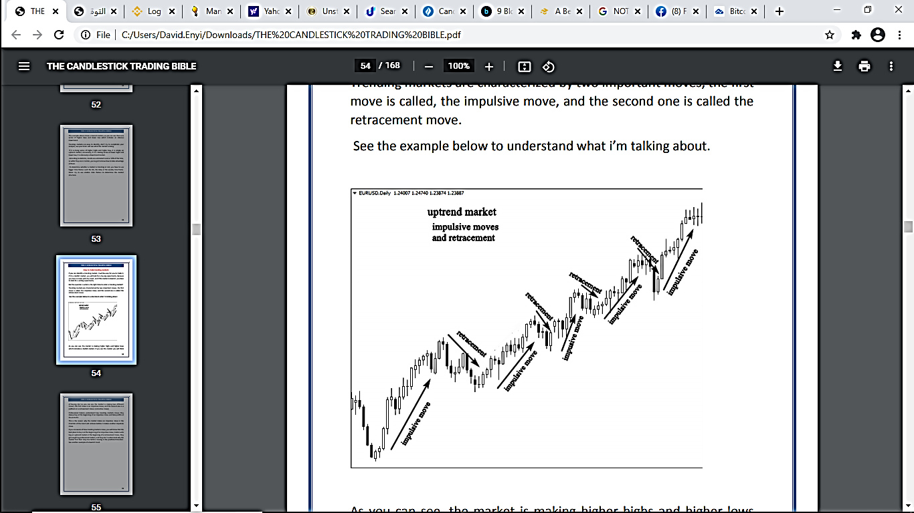
APPENDIX (contains chart t/a examples to be automated)
STRENGTH OF THE MOVE : WE NEED TO BE ABLE TO SPOT HIGH MOMENTUM MOVES SIGNALING PRESENCE OF BANKS AND INSTITUTIONS
GOOD PROFIT ZONE: LEEL MUST PROVVIDE GOOD RISK/REWARD RATIO
BIGGER TIME FRAMES: DAILY AND 4 HOUR MUST BE TRACKED AS THEY ARE THE MOST POWERFUL ZONES IN THE MARKET

Slide 11
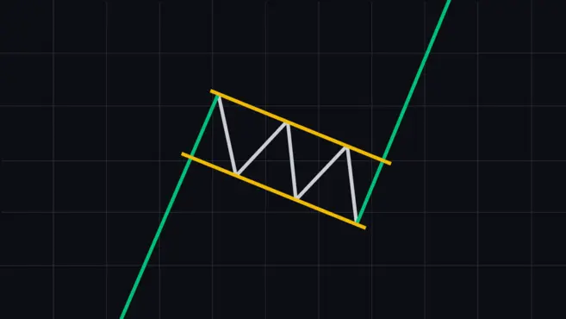
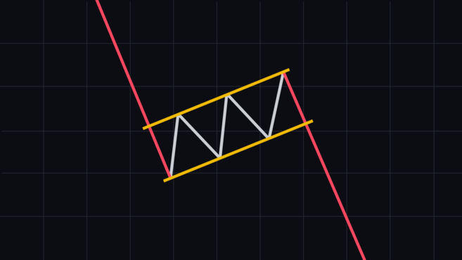
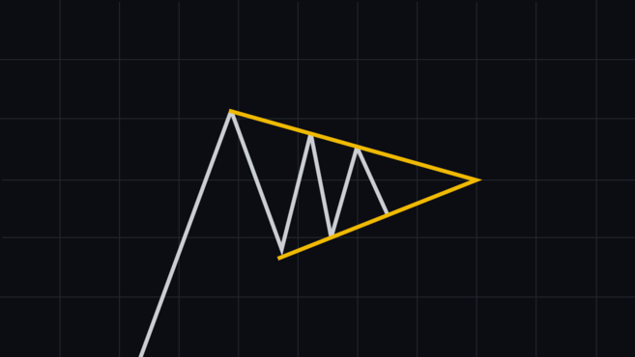
SCENARIOS THAT OUR APP MUST BE ABLE TO IDENTIFY AND INTERPRET TO USER
Bull flag
Bear flag
Pennant

Slide 12
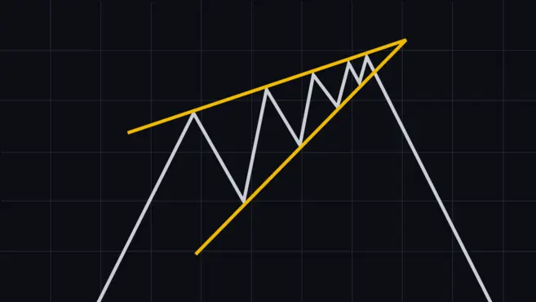
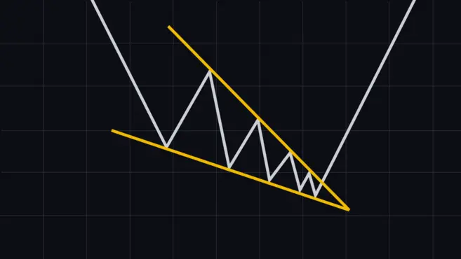
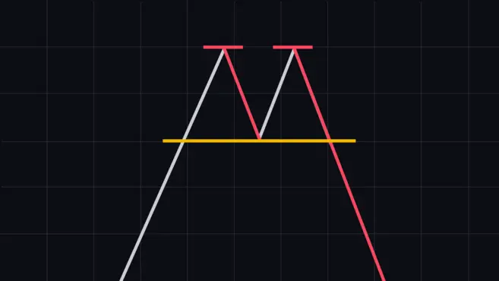
SCENARIOS PT 2
RISING WEDGE
FALLING WEDGE
DOUBLE TOP & DOUBLE BOTTOM

Slide 13
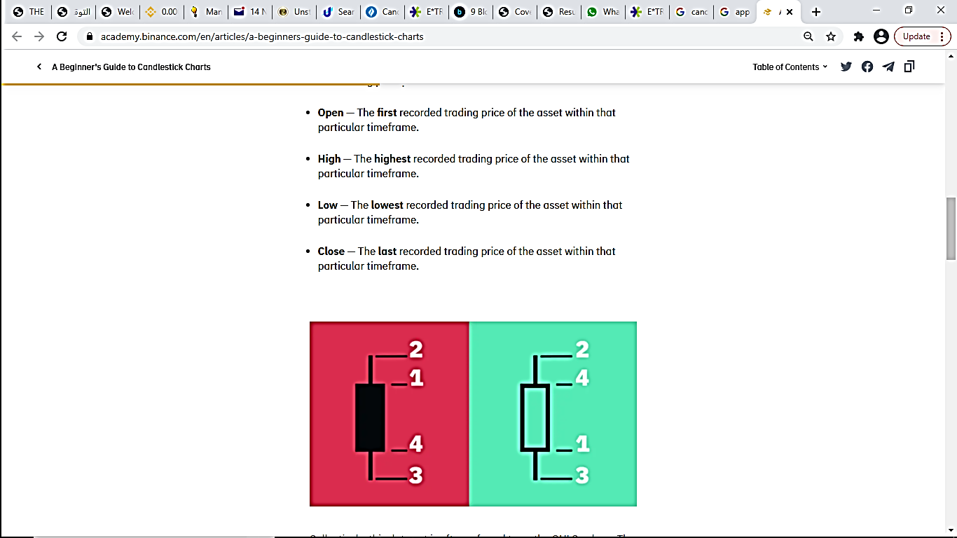
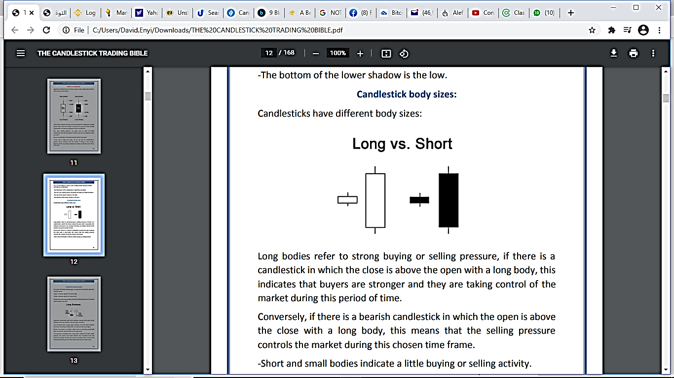
ANATOMY OF A CANDLESTICK

Slide 14
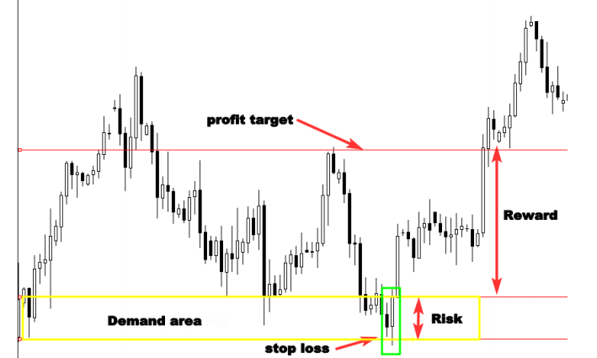
RISK TO REWARD setup

Slide 15
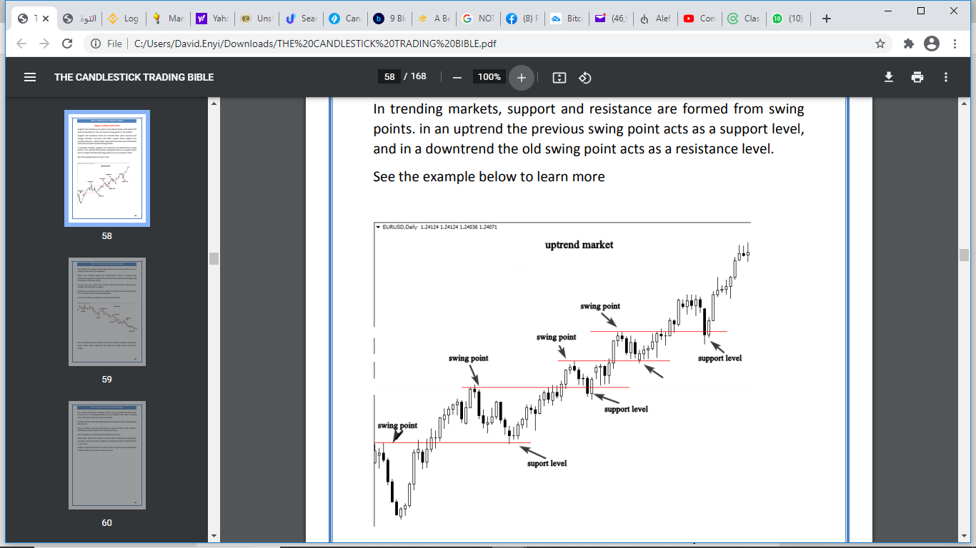
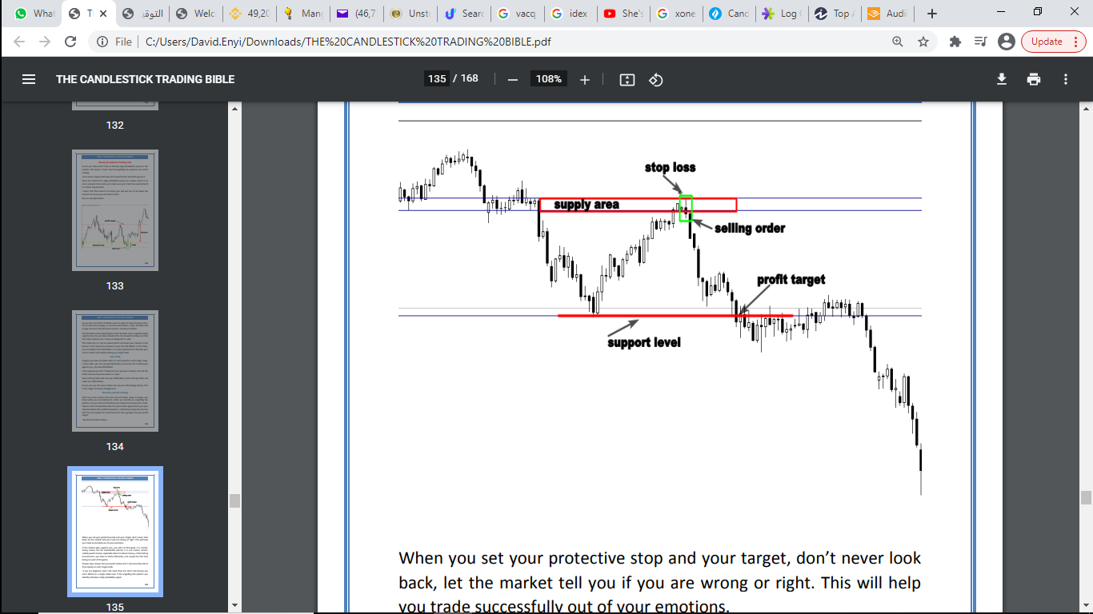
PRICE ACTION STRATEGY USING SUPPLY AND DEMAND ZONES

Slide 16
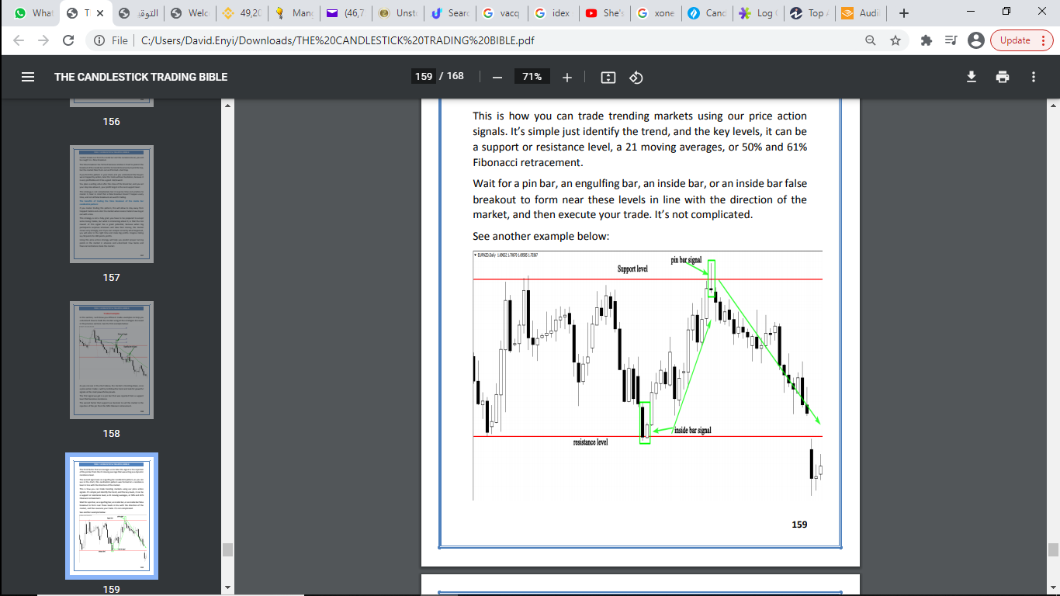
HIGH PROBABILITY SETUP SCENARIO
STEPS TO BE AUTOMATED FOR TRADING A TRENDING MARKET
IDENTIFY THE TREND (UPWARD OR DOWNWARD)
IDENTIFY KEY LEVELS (SUPPORT,RESISTANCE, 21 MOVING AVERAGES, 50% & 61% FIBONACCI RETRACEMENT)
MARK OUT PIN BAR/ENGULFING BAR/ INSIDE BAR WHEN IT FORMS NEAR KEY LEVELS AND EXECUTE TRADE.
PREDICTIVE BEHAVIOUR OF CHARTS IF THEY BREAK SUPPORT AND RESISTANCE

Slide 17
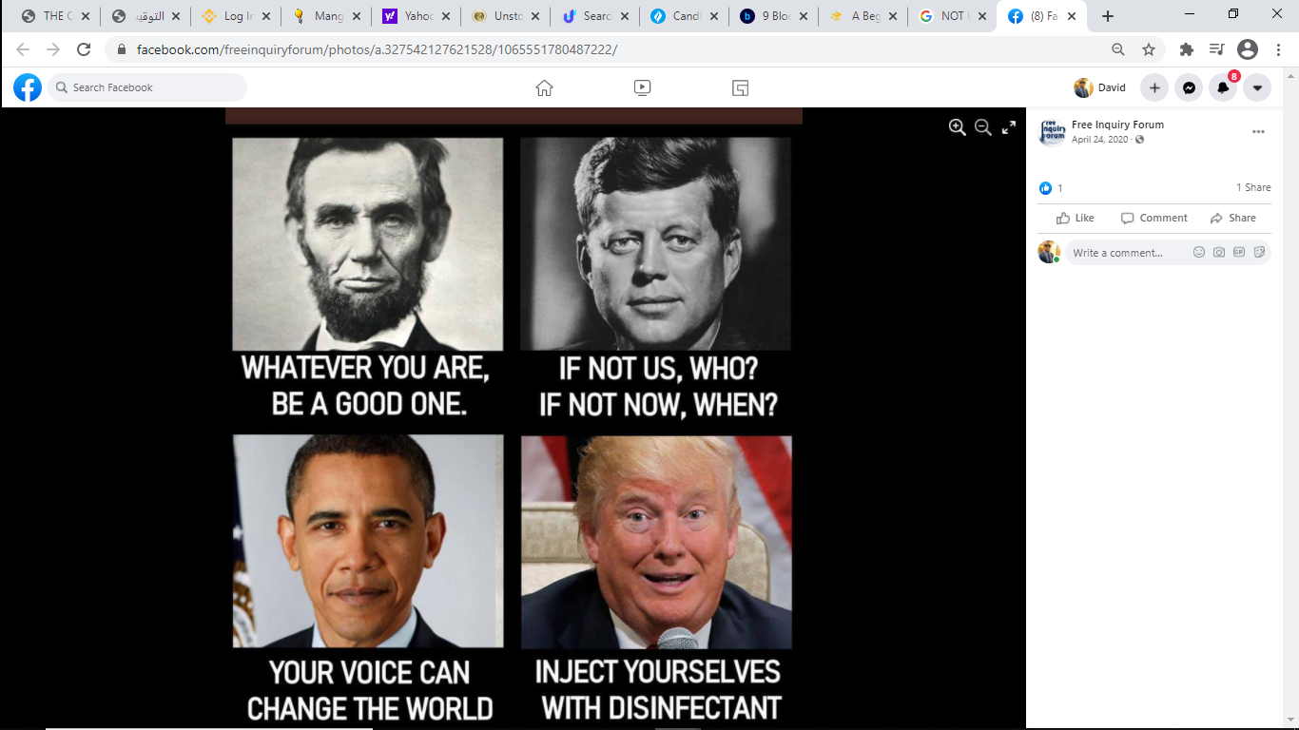
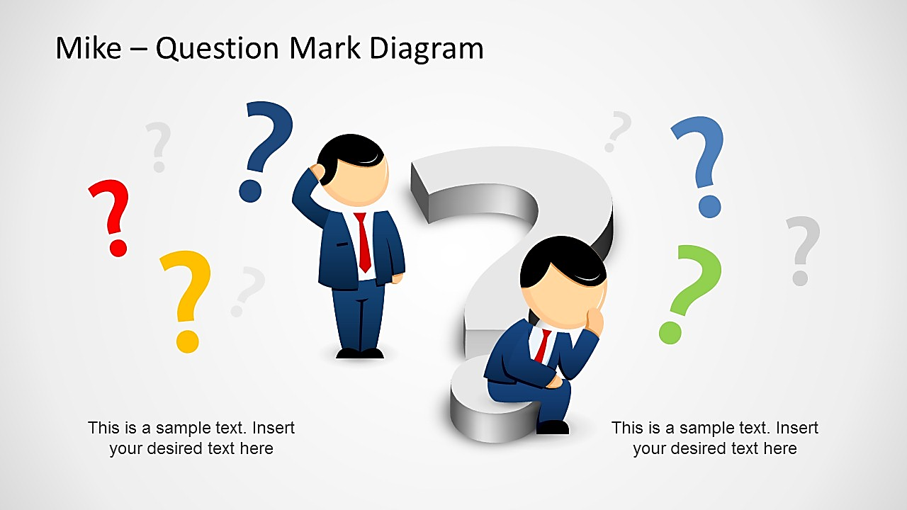
Closing remarks
QUESTIONS ??

